Slide 1
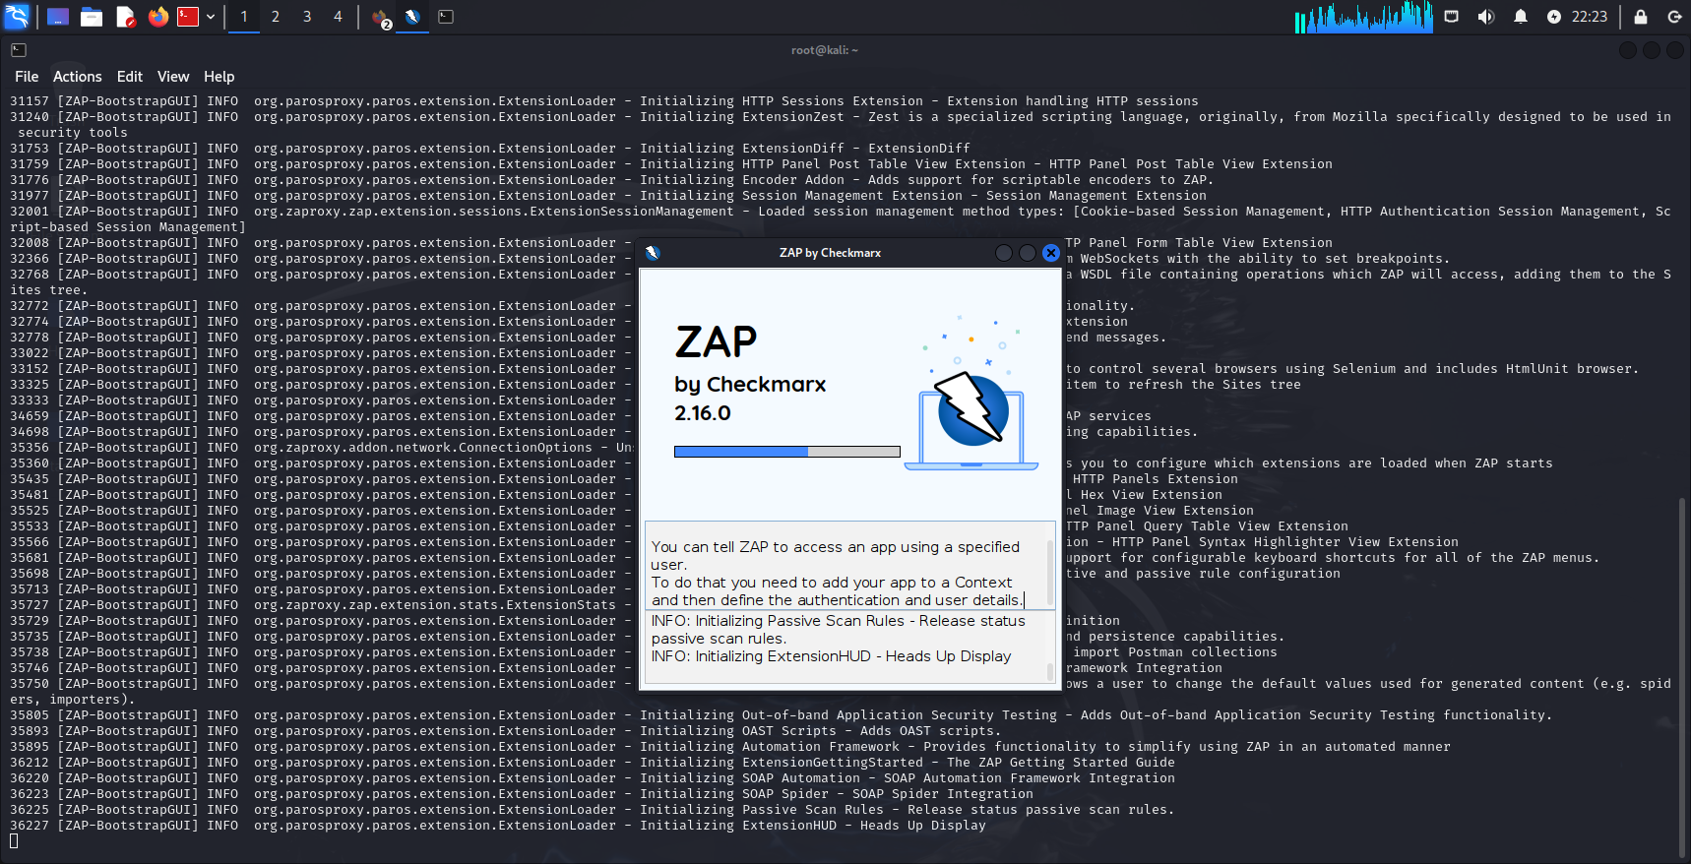
TASK 2
Domain : https://zero.webappsecurity.com/
I have used Zaproxy in Kali Linux instead of Netsparker .STEP 1 : Open Kali linux -> terminal -> Write Zaproxy to open .

Slide 2
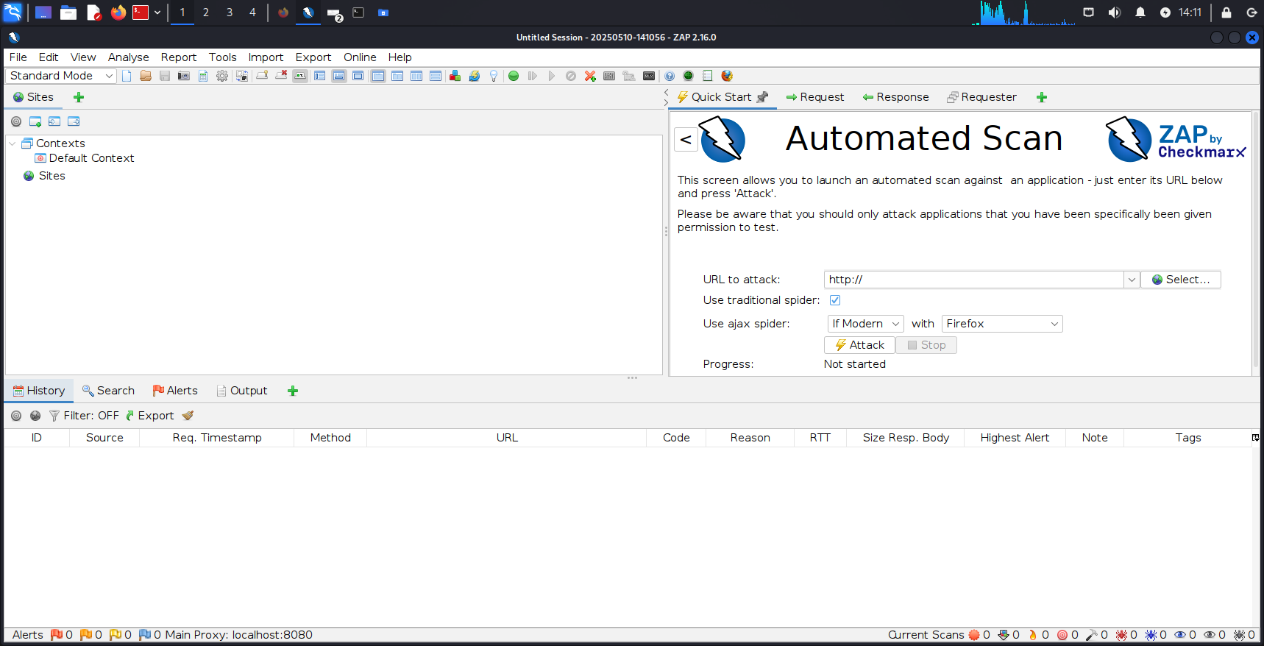
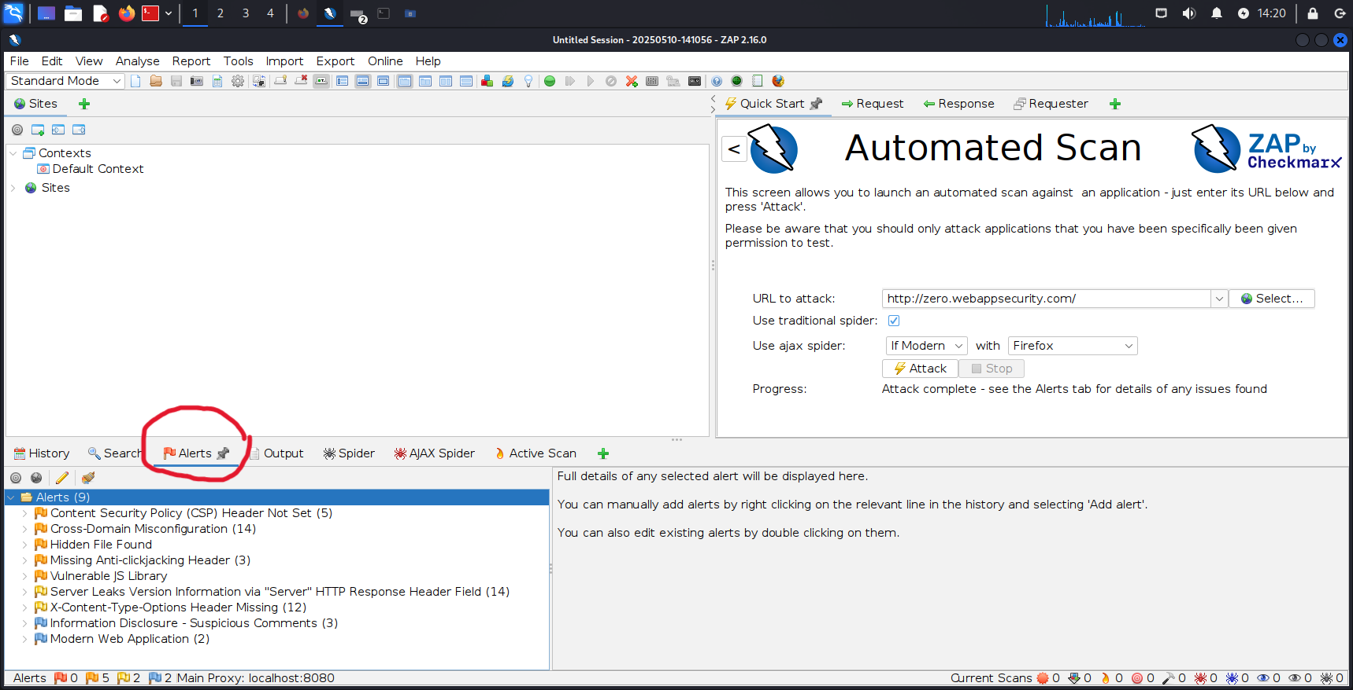
Step 2 : This interface will appear and then you have to add the requested website URL to find vulneralibilities . After adding URL click on “Attack”.
Step 3 : After performing an active scan Go to the alerts section where you can see all the discovered vulneralibilities

Slide 3
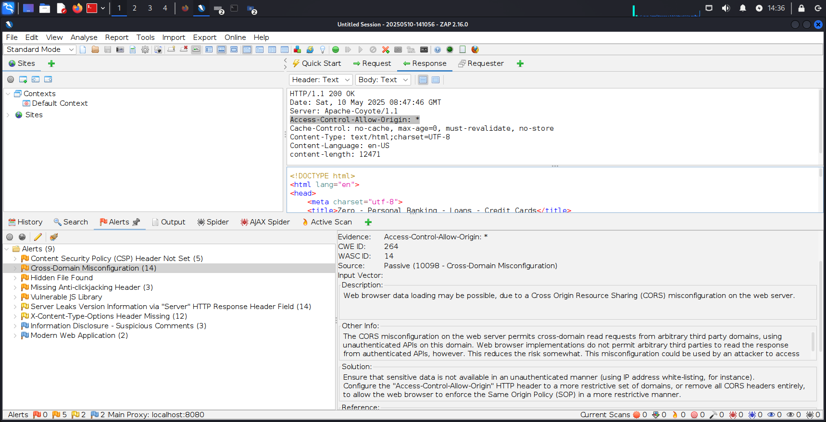
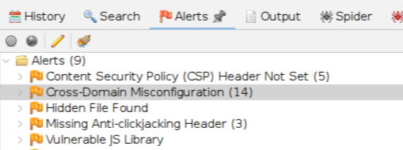
Step 4 : In the Alert Section click on any vulneralibility and it will provide its description , Risk , confidence , solution etc
→ Step 5 : Critical vulneralibilities found now we have to report them

Slide 4
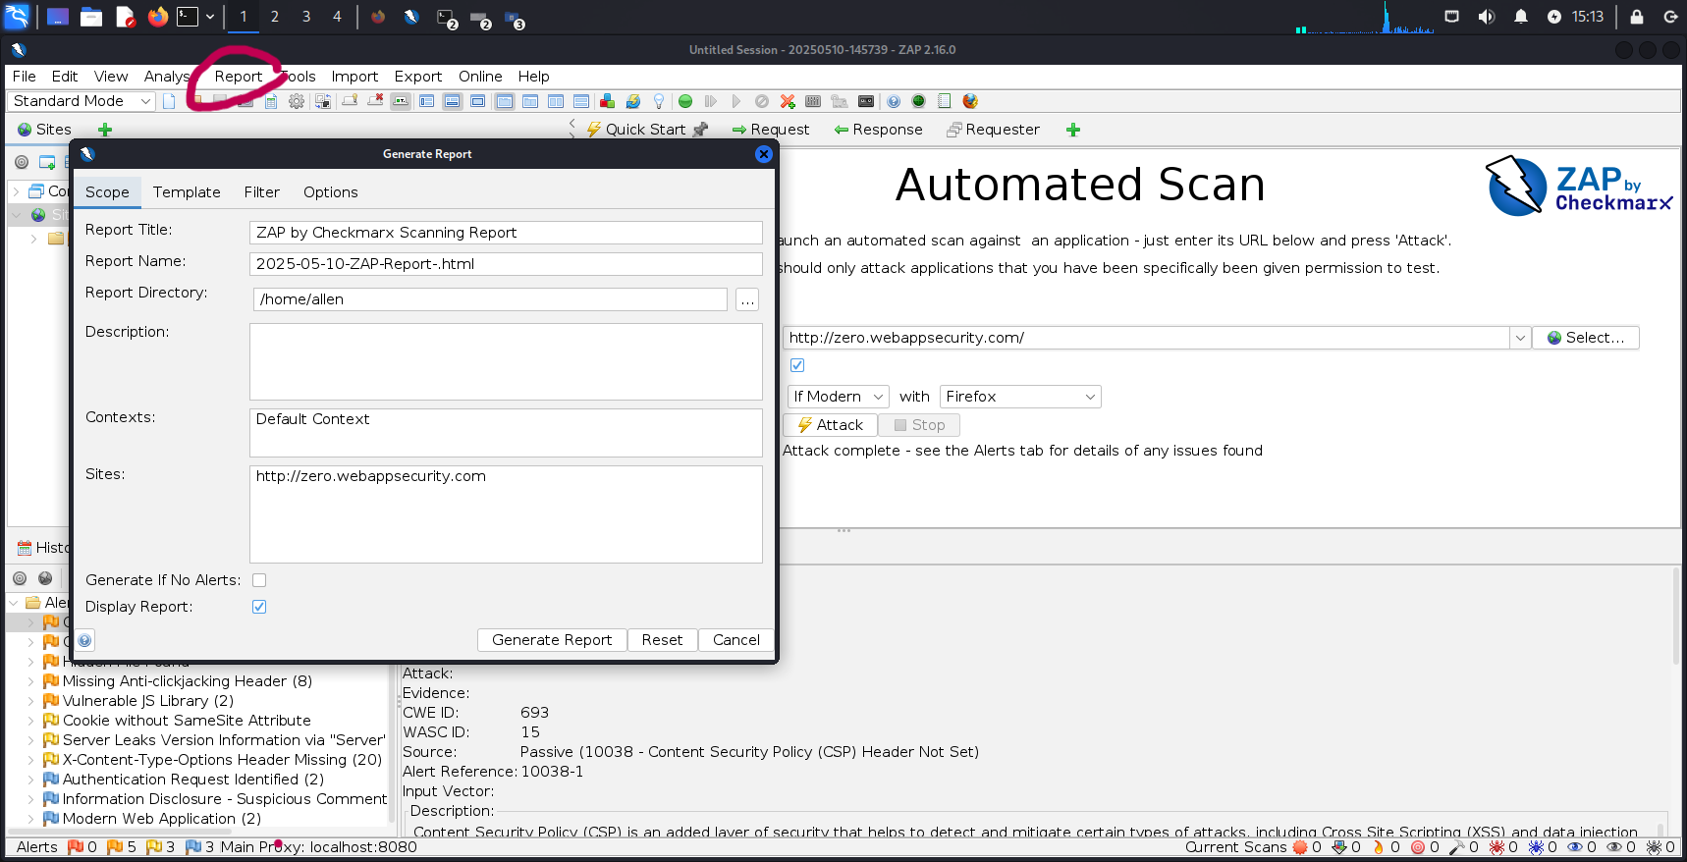
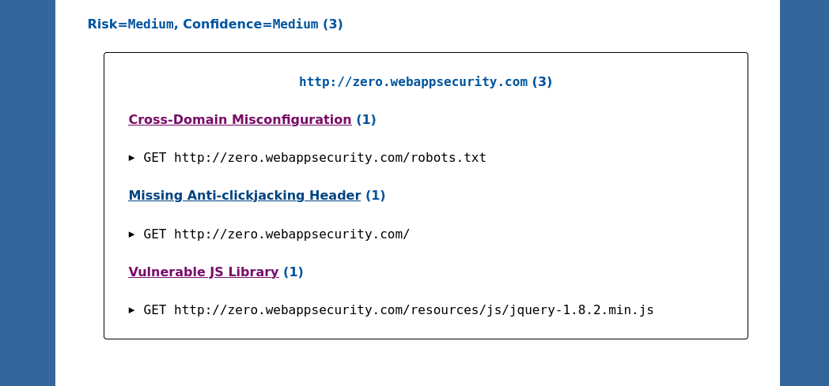
Now you have to go to the report section and generate report and a ZAP based report would be generated .
ZAP report on the critical vulneralibilities found →

Slide 5
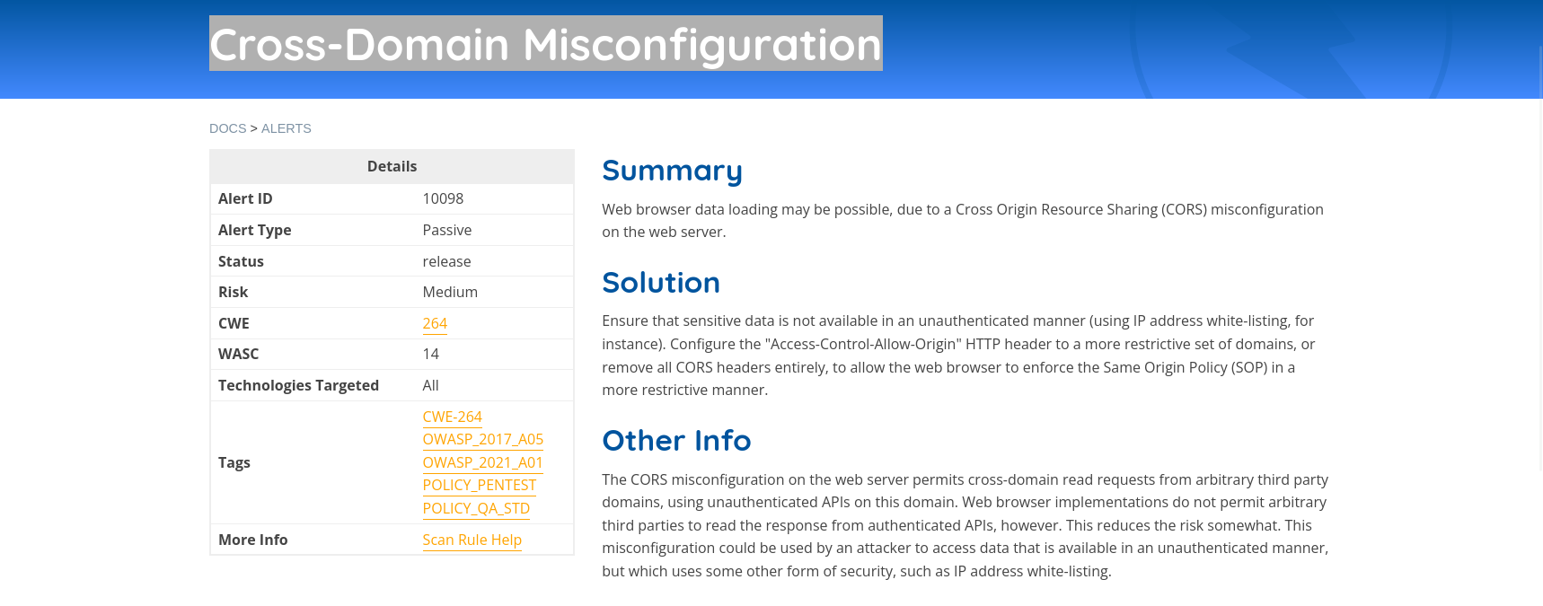
Now I have picked a critical vulneralibility according to ZAP report
Evaluation Report : Cross Domain Misconfiguration on https://zero.webappsecurity.com/
Tools Used :
OWASP ZAP (Zed Attack Proxy )
Mode : Active Scan
Cross Domain Misconfiguration occurs when a web application improperly configures CORS headers allowing external domains to interact with sensitive application resources leading to unauthorized data access , session hijacking or even CSRF .

Slide 6
Details from the scan :
URL : https://zero.webappsecurity.com
Request : A request was made on the page with custom origin header
Response : The server returned a response containing the Access-Control-Allow-Origin header
Impact : An attacker could host a malicious website and use Javascript to send authenticated requests to the vulnerable application potentially retrieving sensitive data like account information or other user specific resources depending on session management .
Steps : 1) Open ZAP and run active scan on the URL . 2) In the Alerts tab you can see Cross Domain Misconfiguration . 3) Use ZAP request editor and then modify it and send a request .4) Check the response for header and you can see it contains (*) or the arbitrary domain you supplied .

